Slide 1



WebIMS
VISHWAKARMA GOVERNMENT ENGINEERING COLLEGE
External Guide
Internal Guide
Prepared By
Manish Lakhara
(Team Lead - Front-end)
Prof. Nirav B. Suthar
Priyansh Savani
(200170107508)

Slide 2
Content
Problem Statement
Project Plan
Roles and Responsibilities
Software & Hardware requirements
Functional and Nonfunctional requirements
Diagrams
Screenshots
Conclusion
Bibliography

Slide 3
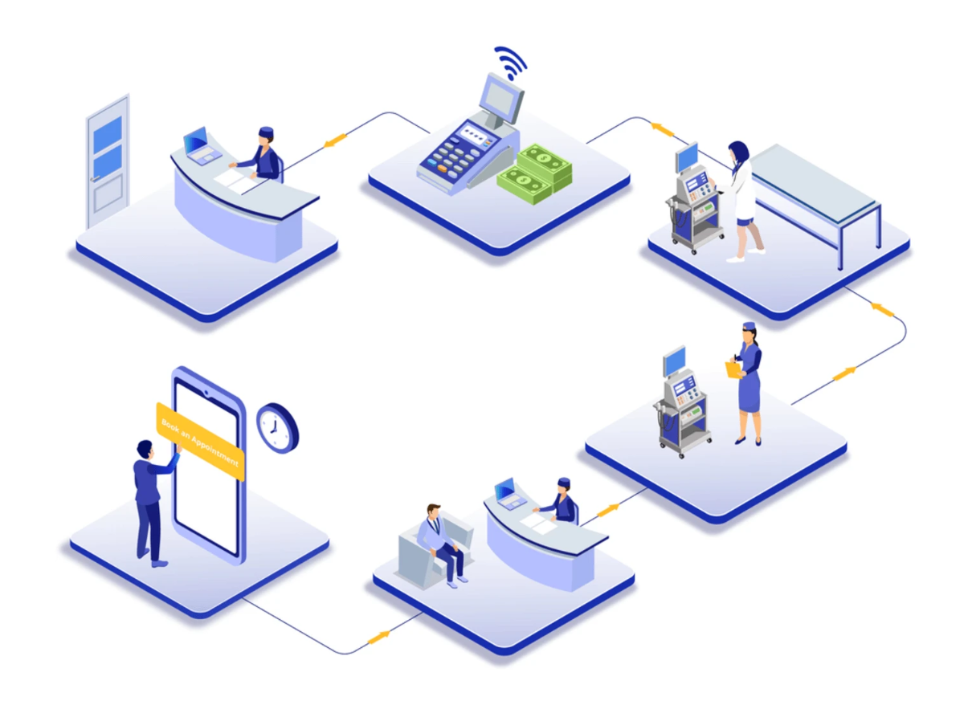
USA Healthcare flow
Appointment Booking
Check In
Meeting with MA
Meeting with Healthcare provider
Medication
Billing

Slide 4
Problem Statement
Traditional paper-based systems to store patient data are time-consuming, error-prone, and can be difficult to manage.
To tackle the above problem EHR (Electronic Health Record) was introduced.
But it was difficult task to secure and manage large amount of patient data generated by health care organizations.
WebIMS will provide one stop solution for all the above problems.

Slide 5
Project Plan
Deployment
Requirement Gathering
We are using agile development model.
First we get requirement from health care organizations.
Based on that designs for front-end and backend are made.
Then we are assigned to develop the feature.
After development the QA will test the feature.
Quality Assurance
Design
Development

Slide 6
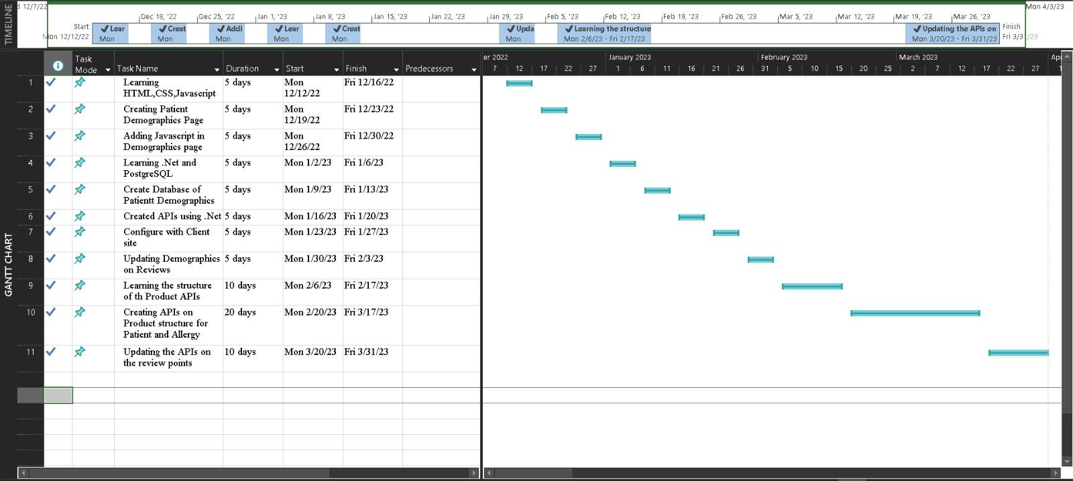
Gannt Chart

Slide 7
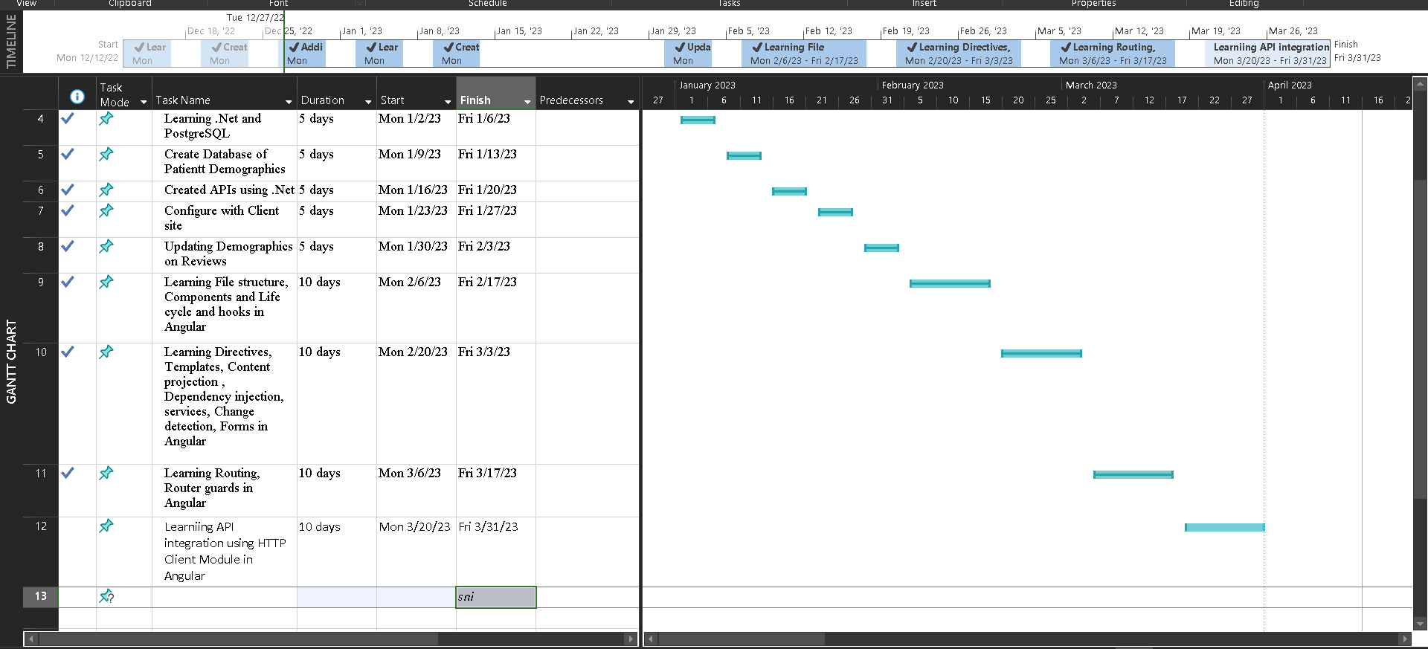
Gannt Chart

Slide 8

Roles and Responsibility
Kaushal Jethava
Priyansh Savani
Backend Development
Front-end Development

Slide 9







Software Requirement
HTML 5
JavaScript ES6
Dot Net Core 6
Angular 15
CSS 3
Postgresql

Slide 10
Hardware Requirement
RAM Requirement: 8 GB
Storage: 256 GB SSD
Processor: Intel i5 10th gen
Network steed: minimum 1 mb/s

Slide 11
Functional Requirement
Functional Requirement
User can view available time, book appointment, and receive reminders.
User can manage and store patient medical records electronically.
User can manage billing and insurance claims, including claim submission, tracking, and processing.
User can user use tools for communicating with patients, such as fax, messaging, appointment reminders.

Slide 12
Non Functional Requirement
Nonfunctional Requirement
Application should be able to perform its functions in a timely and efficient manner with minimal delay.
Application should be following HIPAA act to secure patient data.
Application should be reliable and available for use when needed with minimal downtime.
Application should be user-friendly and intuitive with an interface that is easy to navigate and understand.

Slide 13
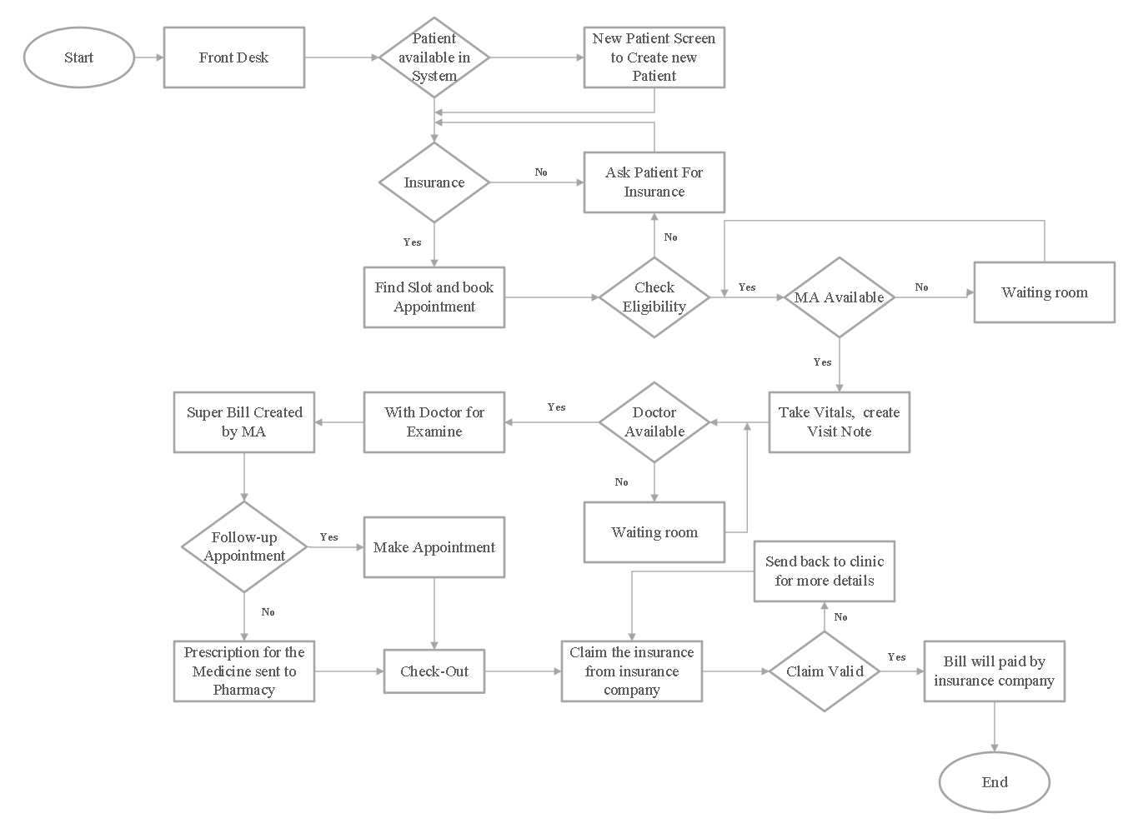
System Flow

Slide 14
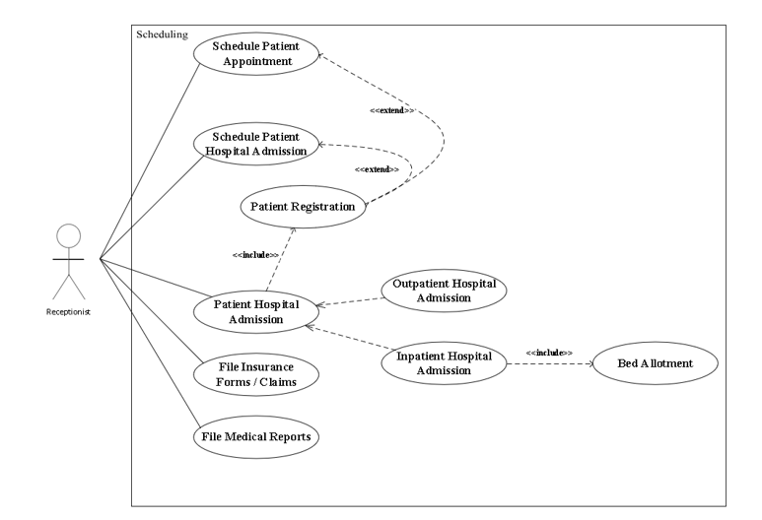
Use case Diagram

Slide 15
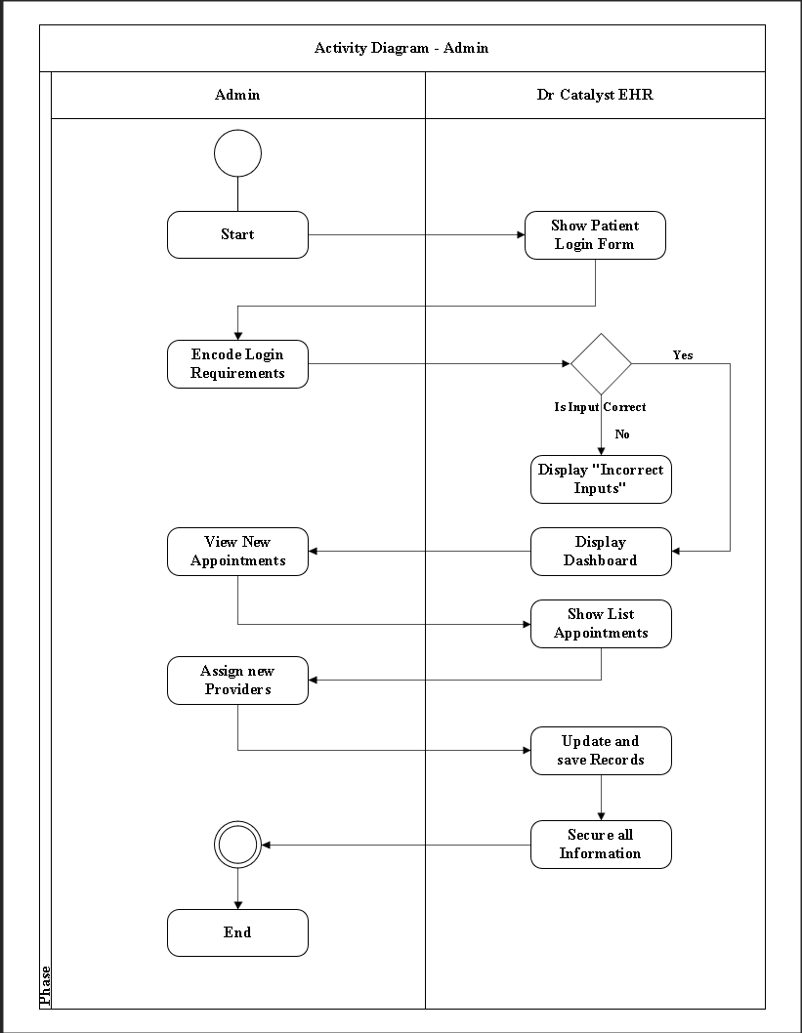
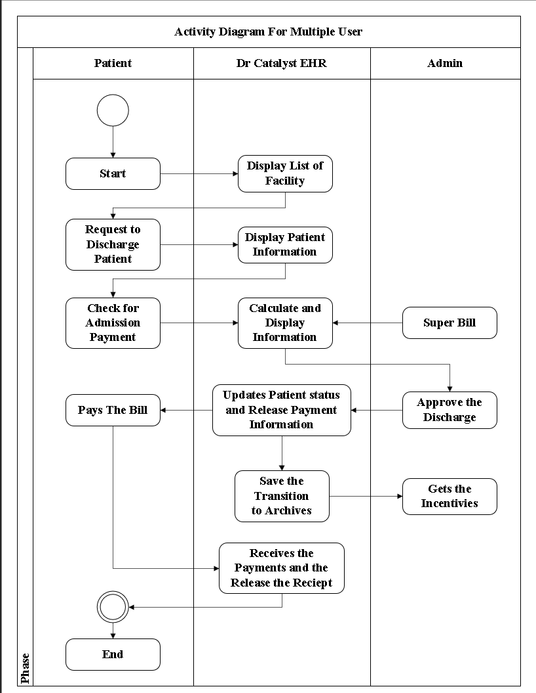
Activity Diagram

Slide 16
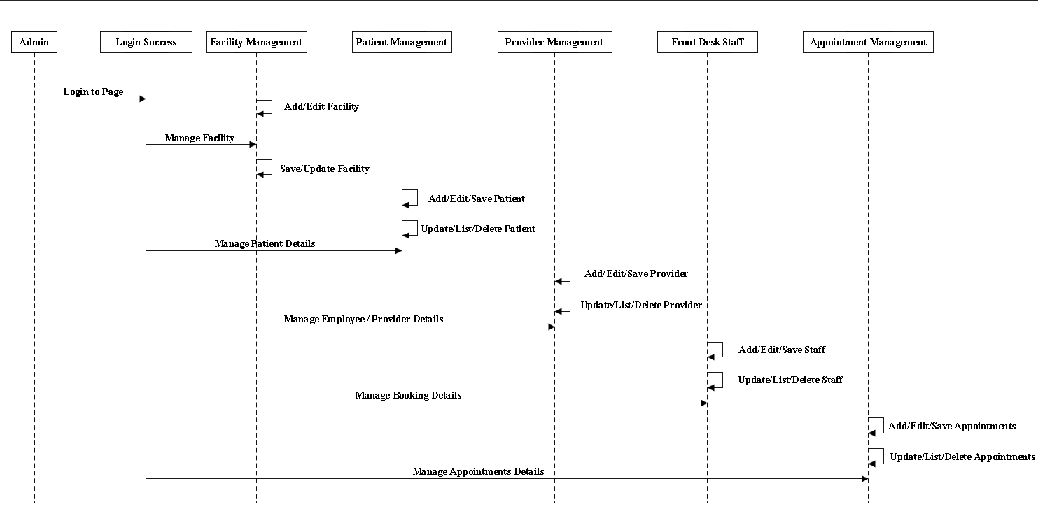
Sequence Diagram

Slide 17
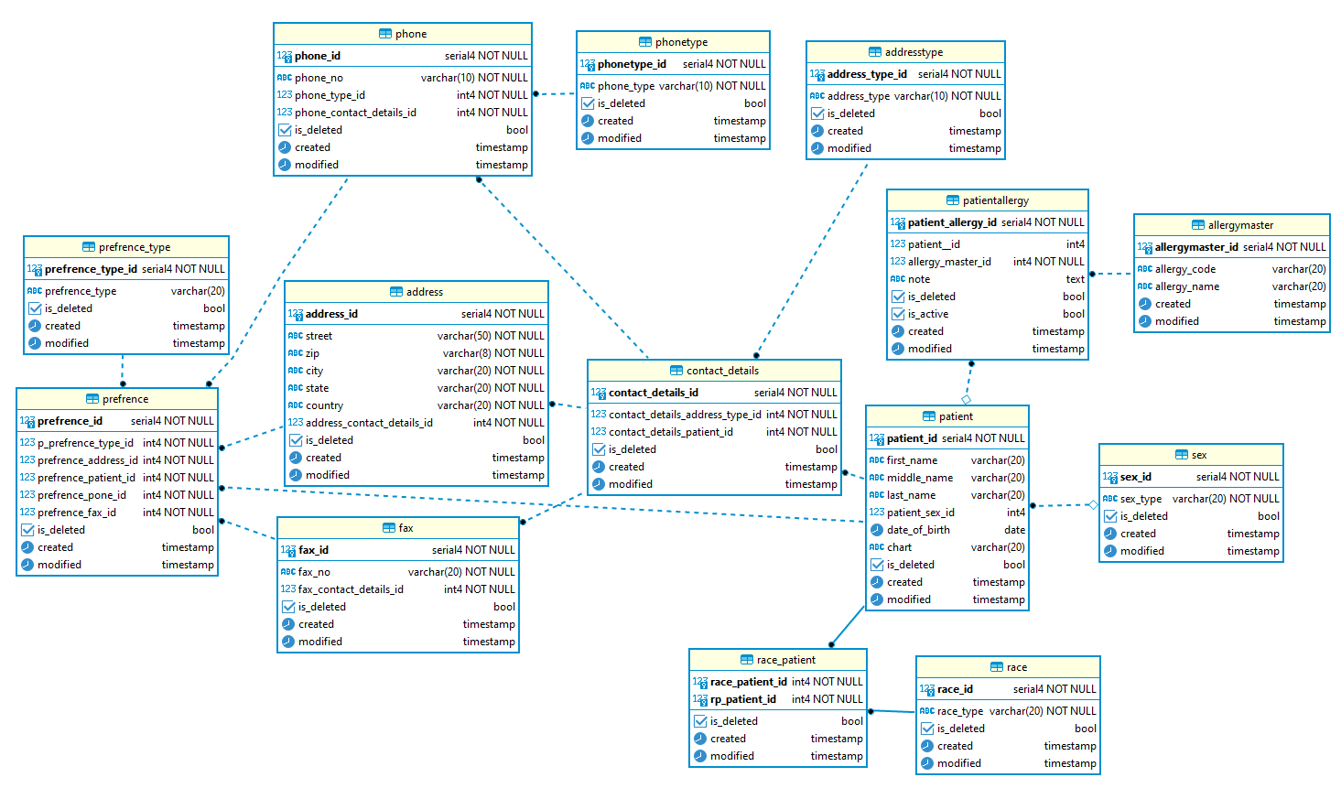
ER Diagram

Slide 18
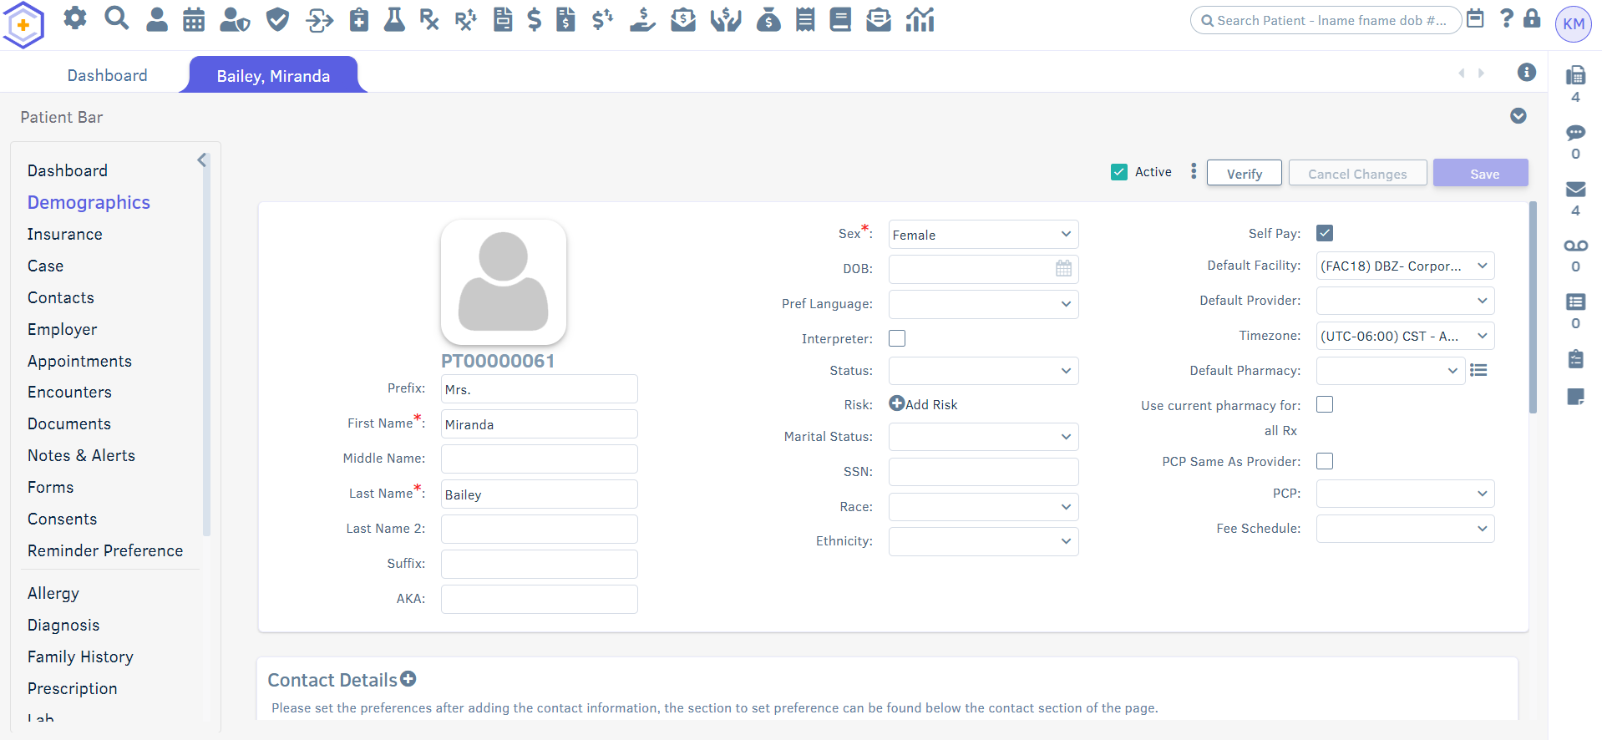
Project Demo (Front-end)
Demographic

Slide 19
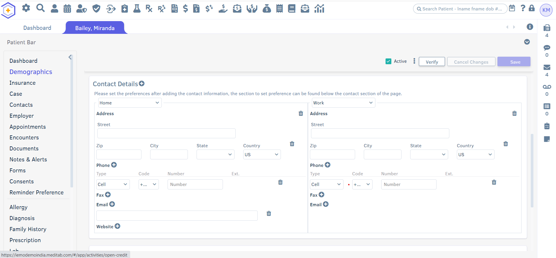
2. Contact Details

Slide 20
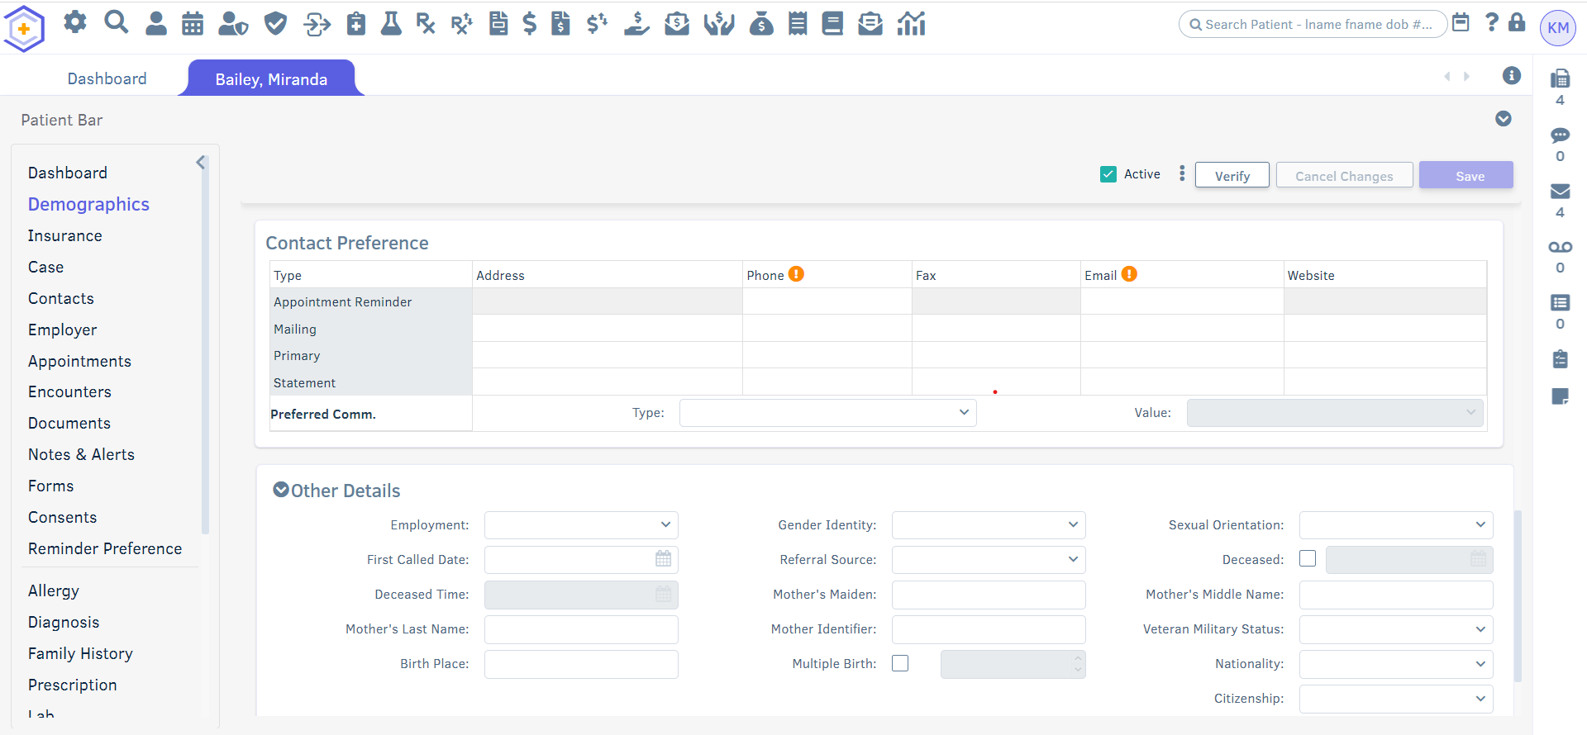
3. Contact Preference & Other Details

Slide 21
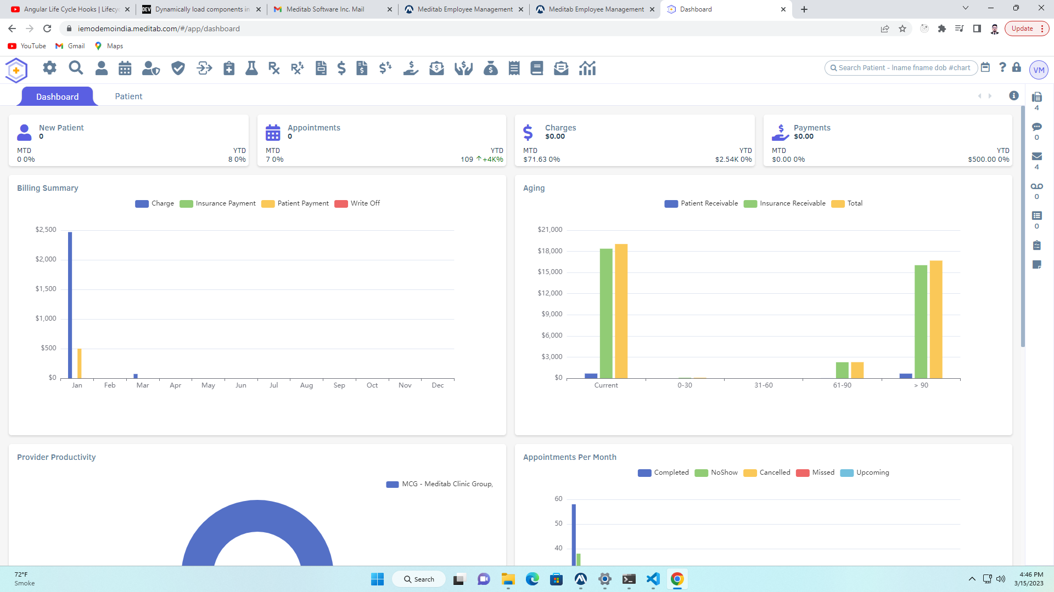
4. Dashboard

Slide 22
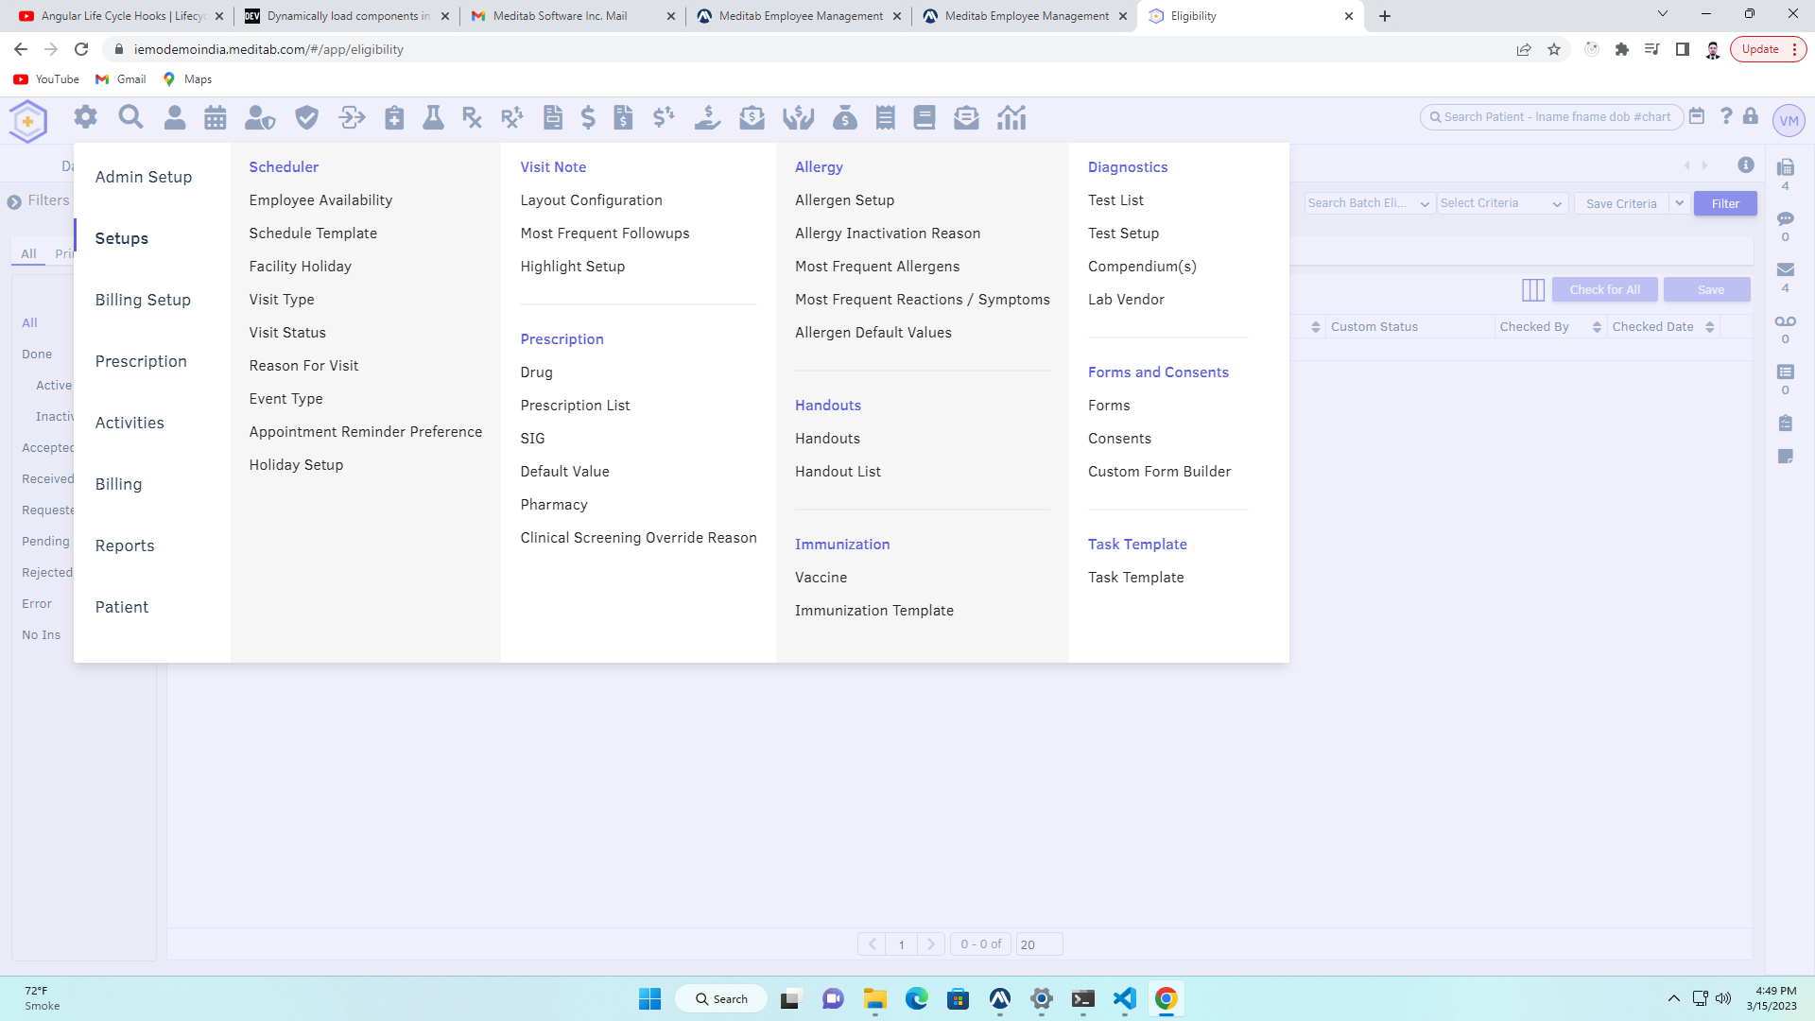
5. Access Page

Slide 23
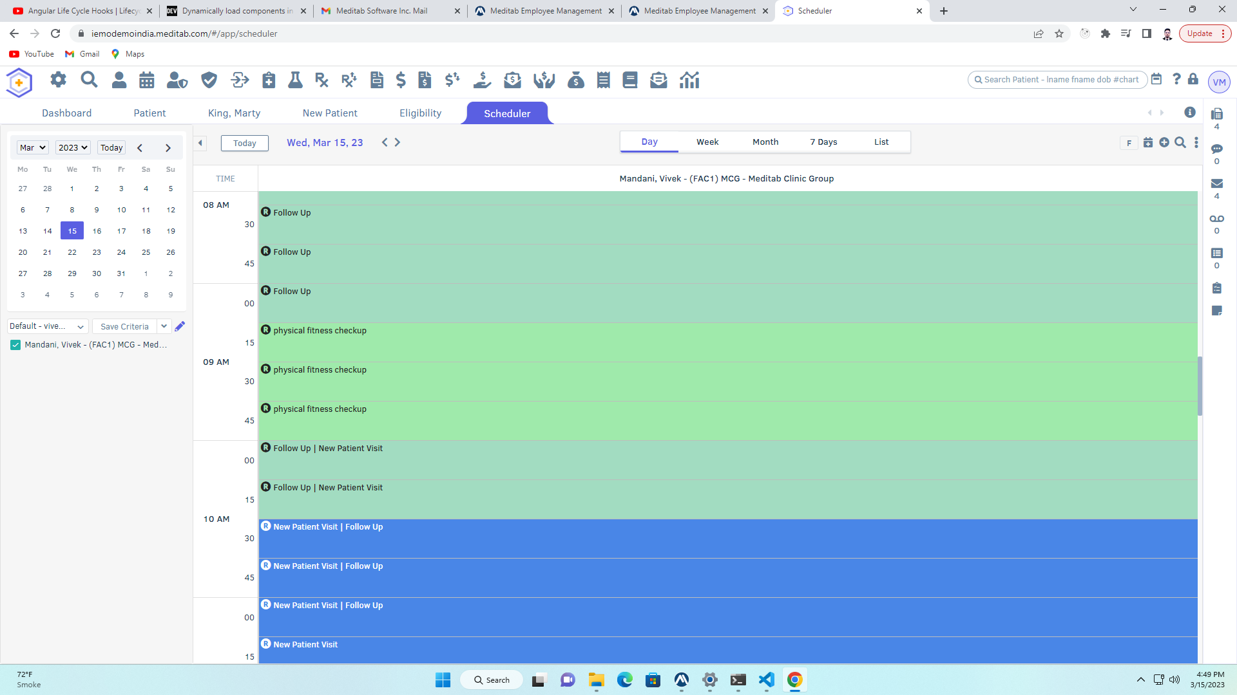
6. Scheduler

Slide 24
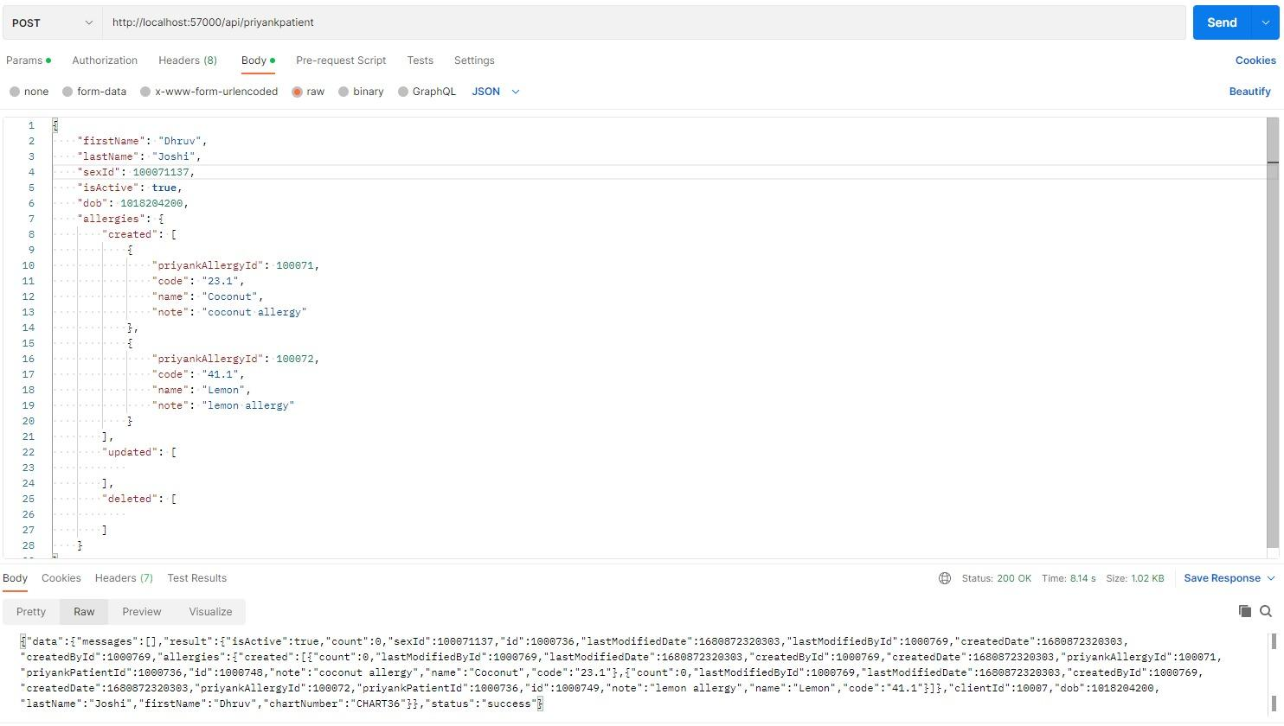
Project Demo (Back-end)
Patient API

Slide 25
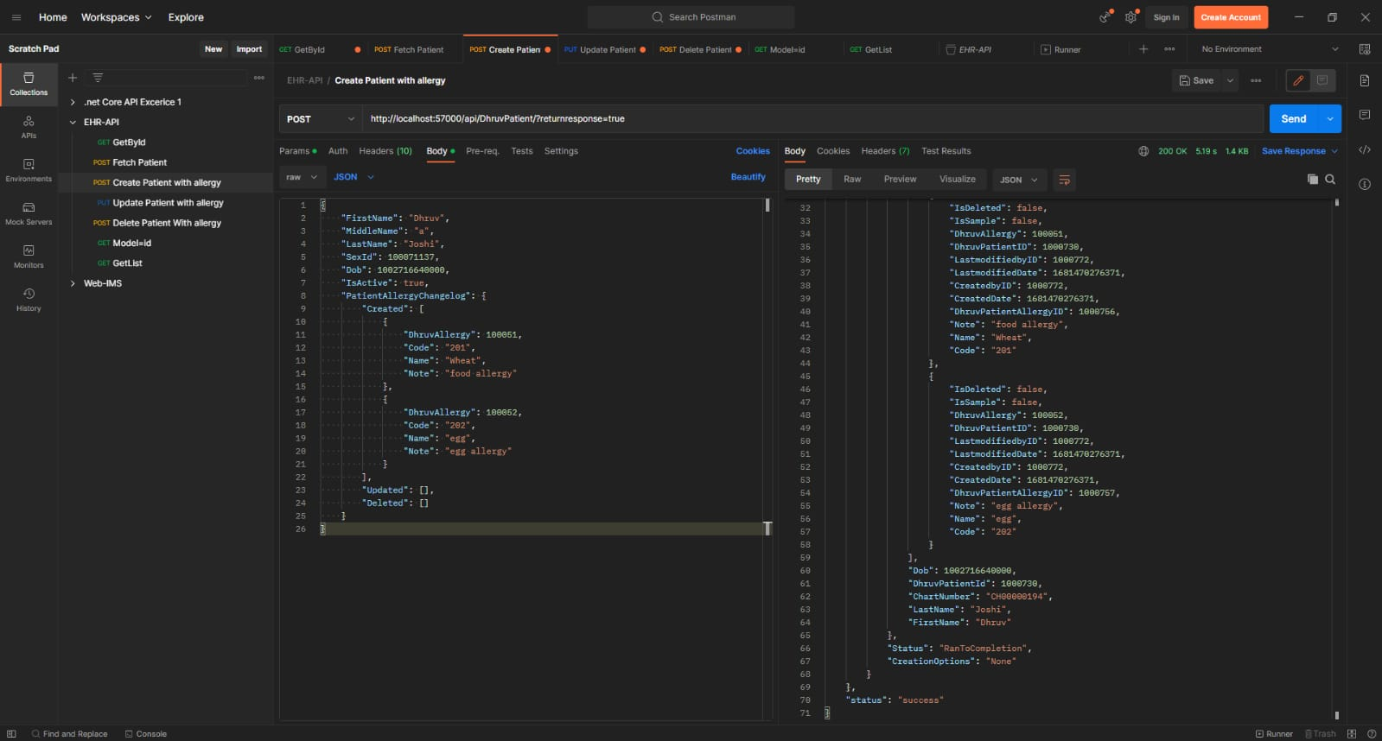
2. API with Body As a Request

Slide 26
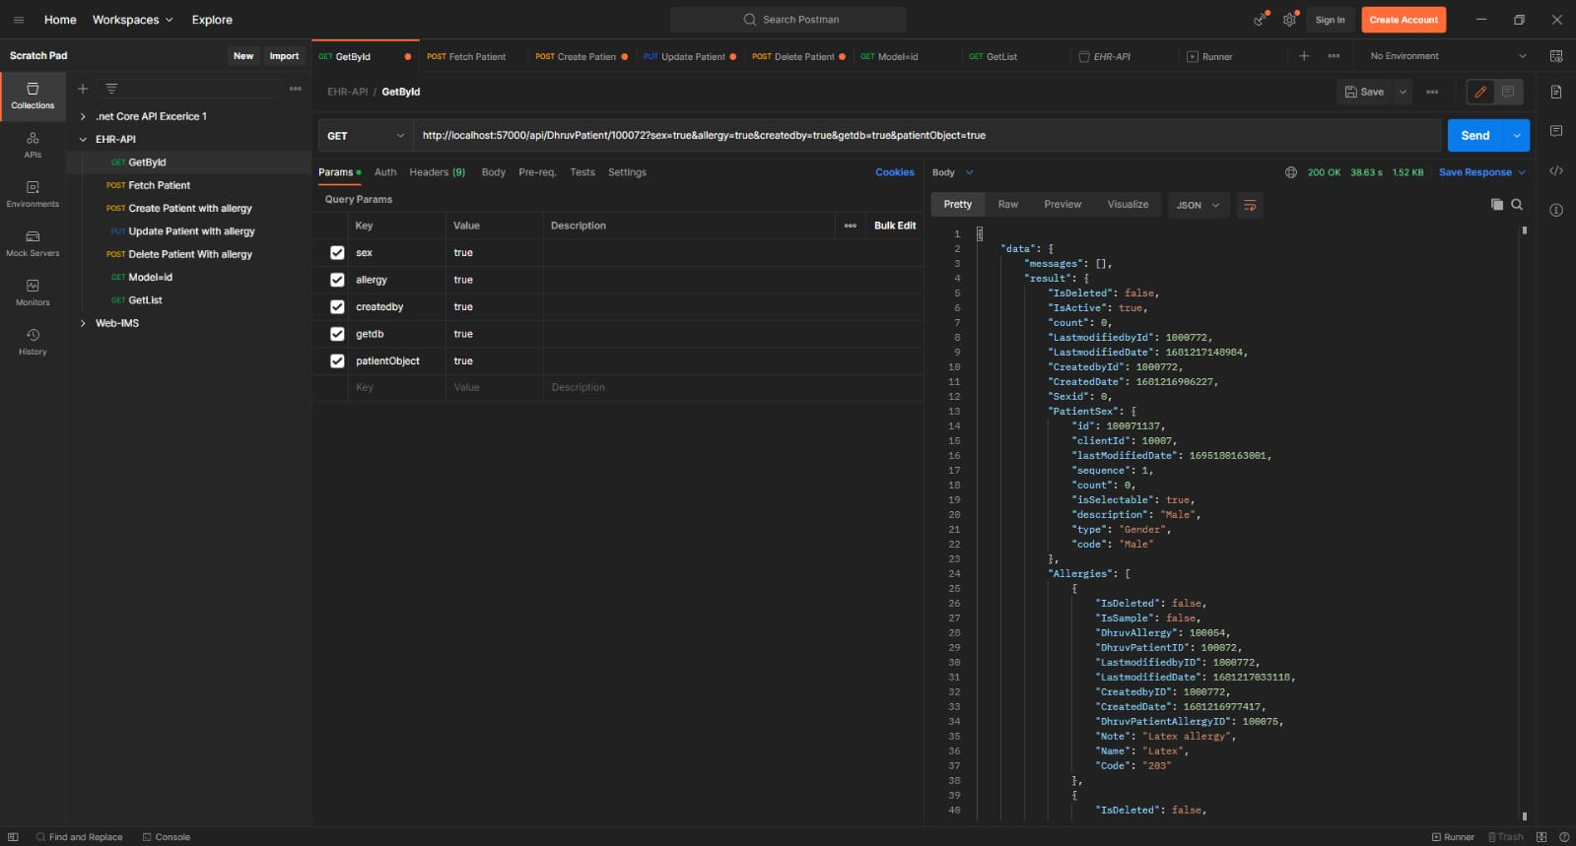
3. GET API with sorting

Slide 27
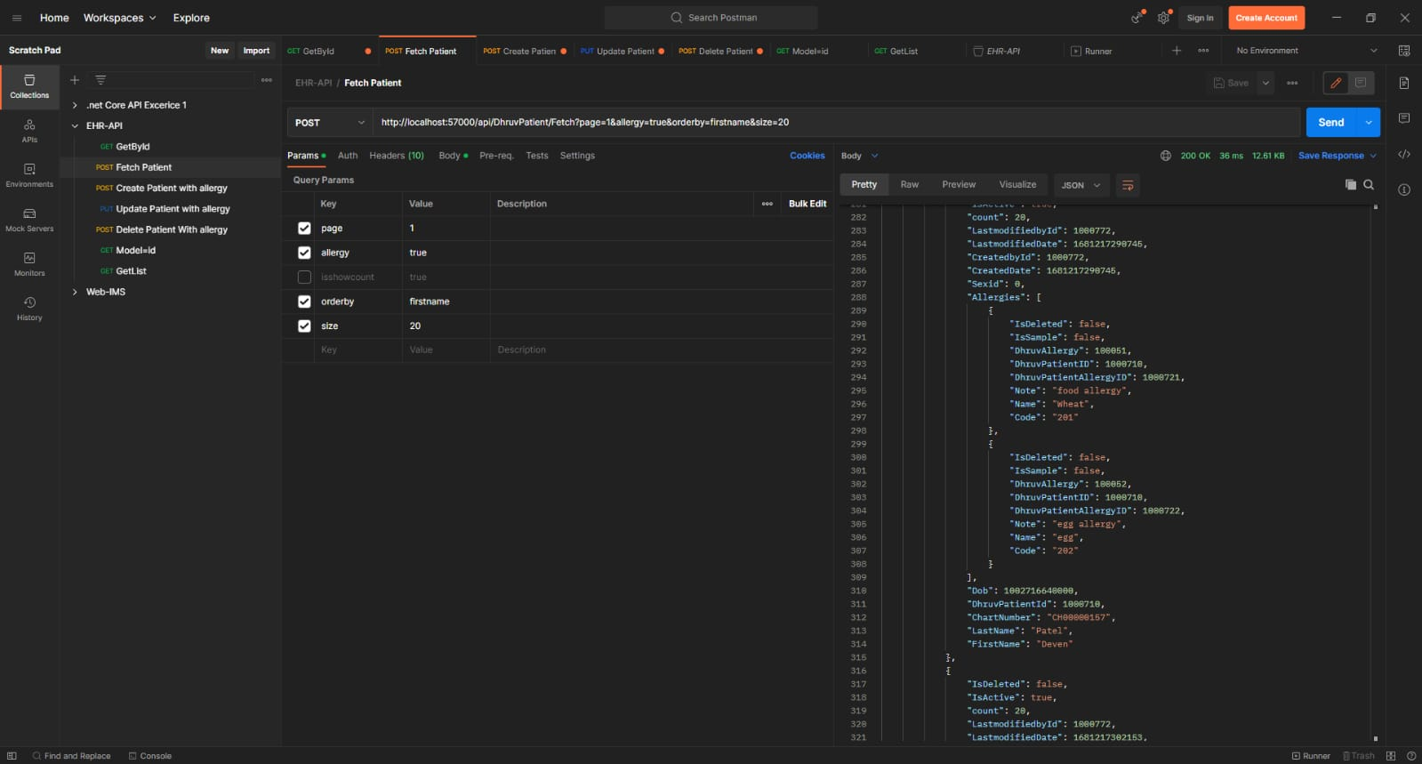
4. POST API With Pagination

Slide 28
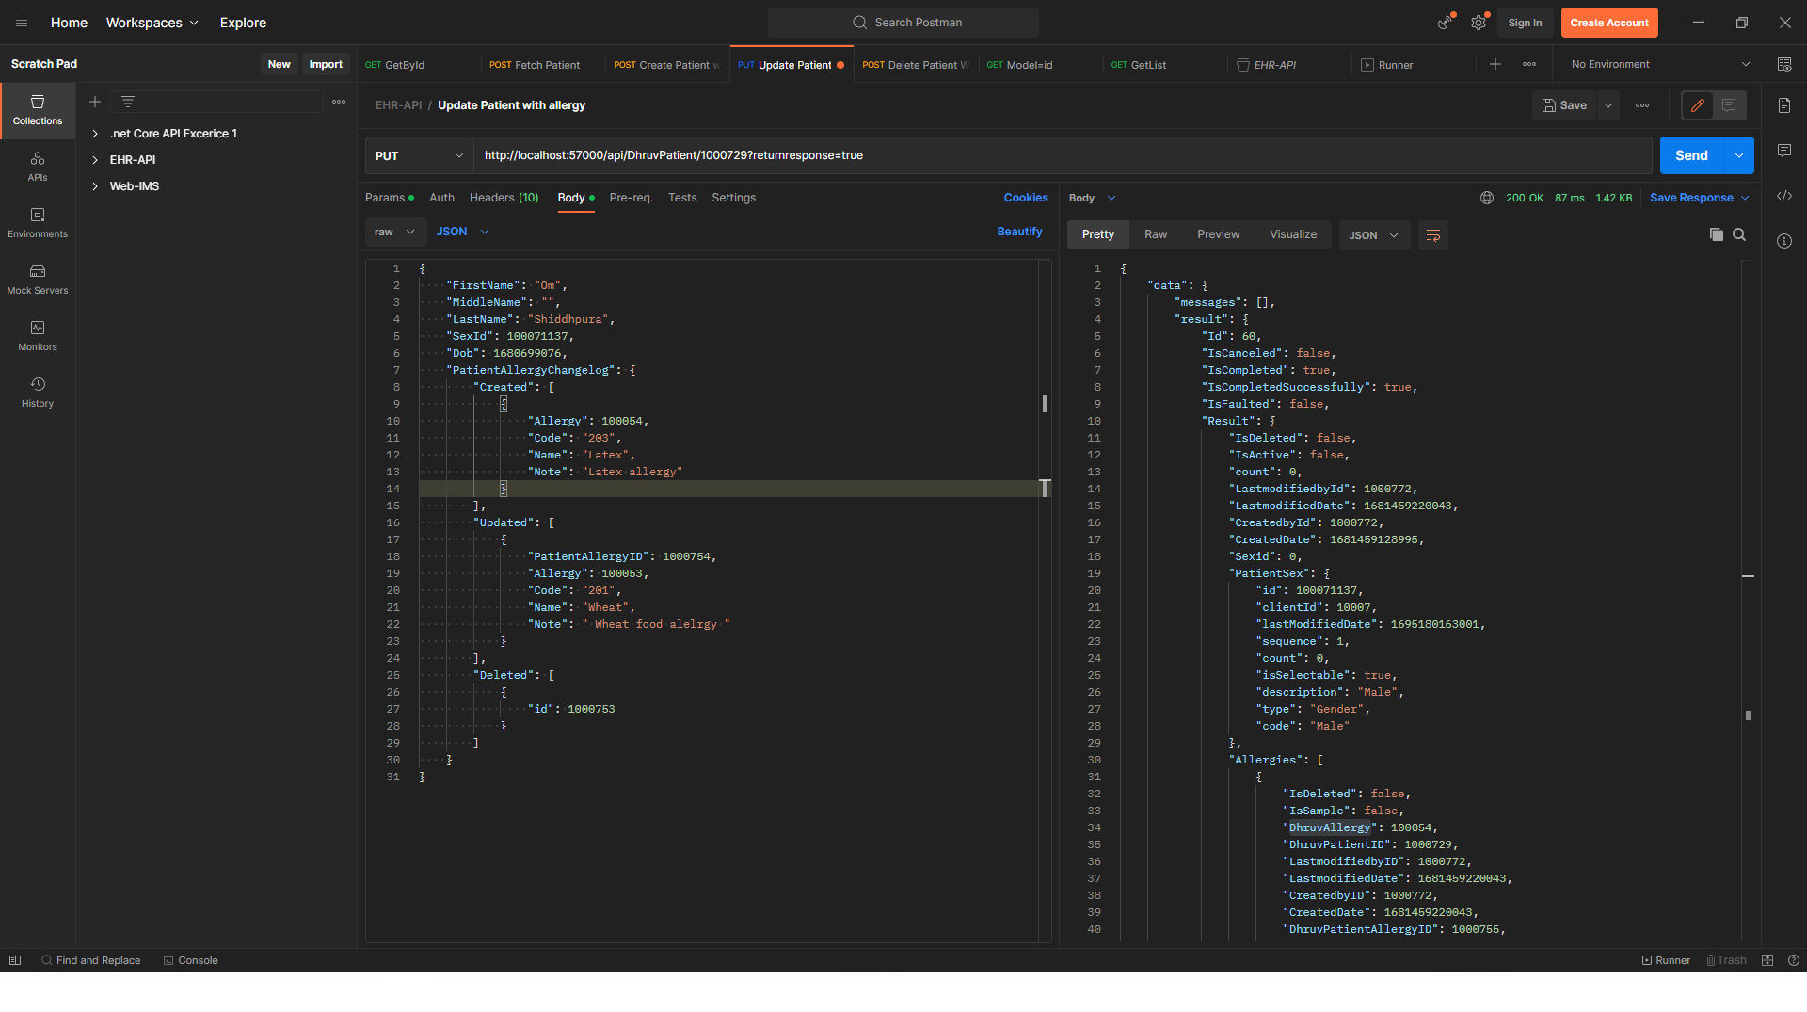
5. PUT API for Updation

Slide 29
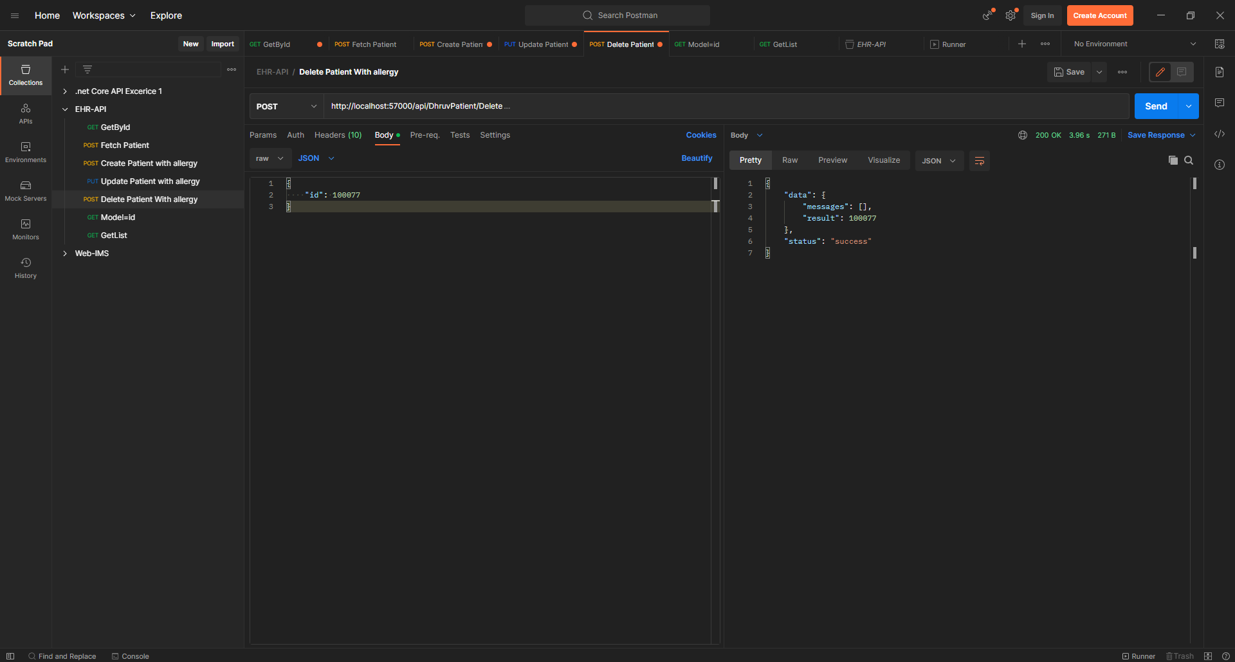
6. API For deletion of Patient data

Slide 30
Limitations
Currently application is supporting English and Spanish languages
Internet Connectivity
Regular updates and maintenance

Slide 31
Future Enhancement
Fix Bugs and issues
To add employee management modules
To add functionalities supported by hospitals

Slide 32
Conclusion
By working on this project we get insight of our company’s major product (IMS – Intelligent Medical Software), also we expanded our understanding about full stack development.

Slide 33
Bibliography
HTML Tutorial. https://www.w3schools.com/html/default.asp. Accessed 5 Feb. 2023.
JavaScript Tutorial. https://www.w3schools.com/js. Accessed 5 Feb. 2023.
CSS Tutorial. https://www.w3schools.com/css. Accessed 5 Feb. 2023.
SQL Tutorial. https://www.w3schools.com/sql. Accessed 5 Feb. 2023.
Angular. https://angular.io/. Accessed 24 Feb. 2023.
Sass: Syntactically Awesome Style Sheets. (n.d.). Sass: Syntactically Awesome Style Sheets. https://sass-lang.com
Rick-Anderson. Get Started with ASP.NET Core. 22 July 2022, https://learn.microsoft.com/en-us/aspnet/core/getting-started.

Slide 34
Thank You

